Slide 1
數位系統實驗
LAB-01
陳培殷
國立成功大學 資訊工程系

Slide 2
Outline
實驗器材和晶片的介紹
Solderless Breadboard
IC (74LS00)
Example
Lab 說明
Lab Notice
Lab 01-1
Lab 01-2

Slide 3
實驗器材和晶片的介紹 - Solderless Breadboard
Introduction of Solderless Breadboard
Solderless Bredboard is a convenient kit for lay outing circuits without any soldering (焊接) work. It is very useful for circuit test and modification during practical training.
Components in lab can be reused with breadboard.
Normally, component’s pins are inserted into holes on breadboard. Every five holes are connected together by a brass stripe under plastic cover. One of holes is connected to component’s pin and the other holes are for circuit connection with jumpers.

Slide 4
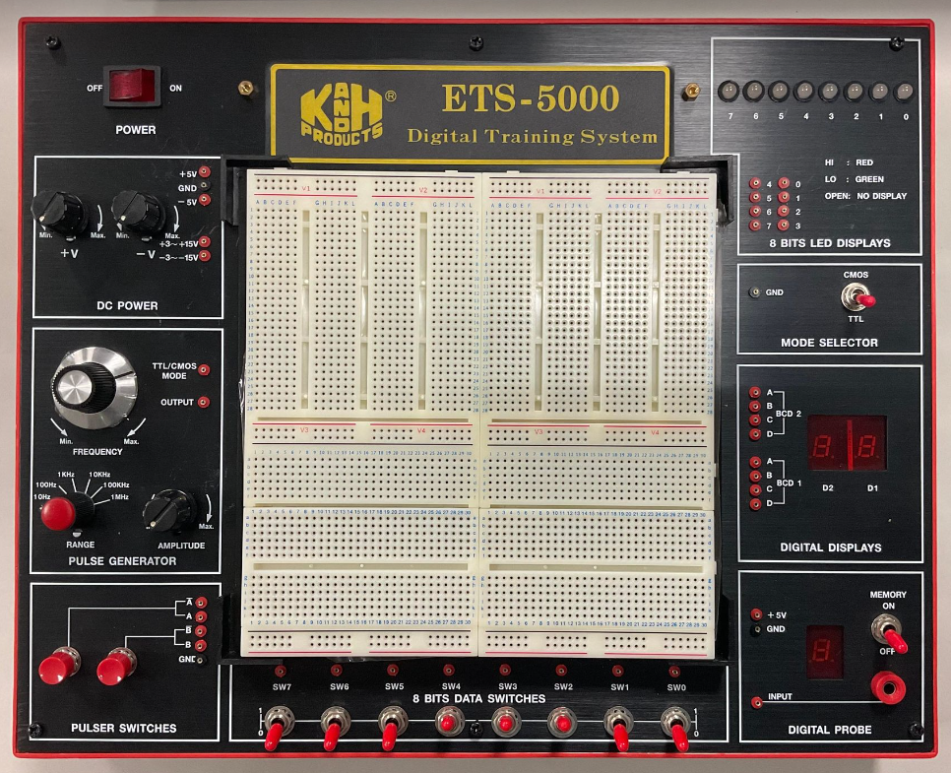
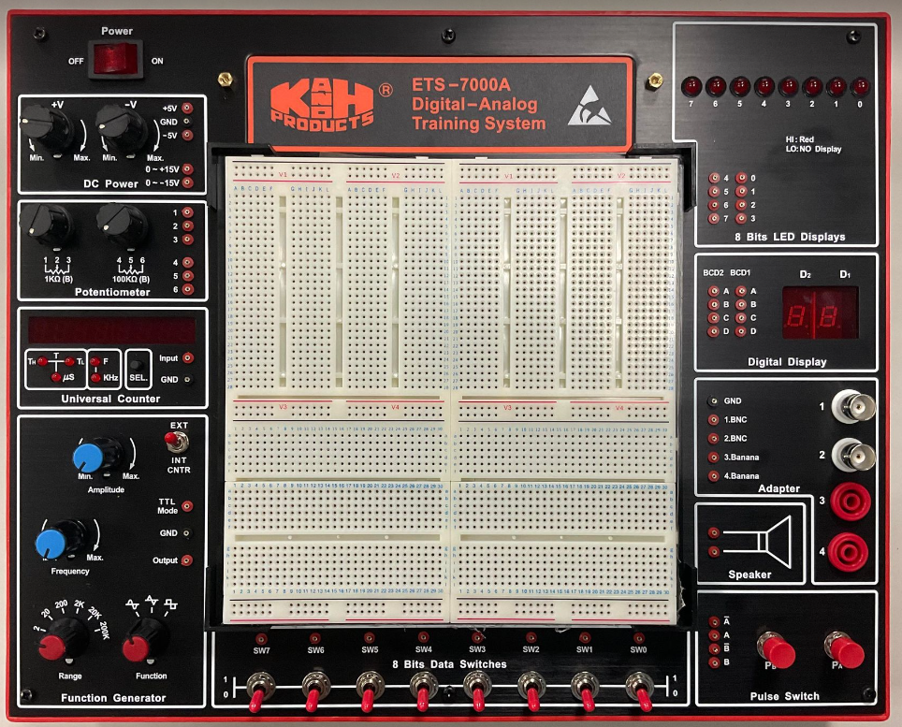
實驗器材和晶片的介紹 - Solderless Breadboard
ETS-5000 & ETS-7000A
20 台左右
5 台左右

Slide 5
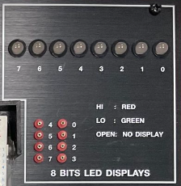
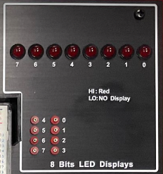
實驗器材和晶片的介紹 - Solderless Breadboard
ETS-5000 & ETS-7000A
ETS-5000
ETS-7000A

Slide 6
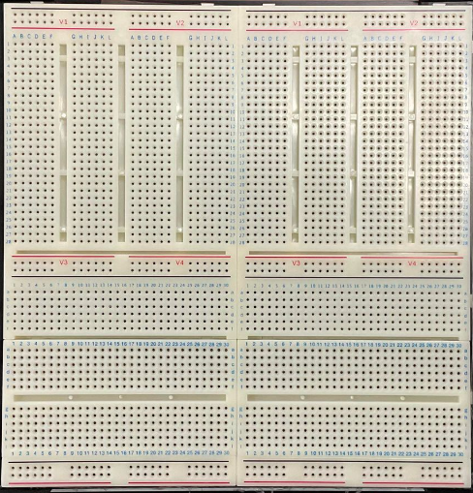
實驗器材和晶片的介紹 - Solderless Breadboard

Slide 7
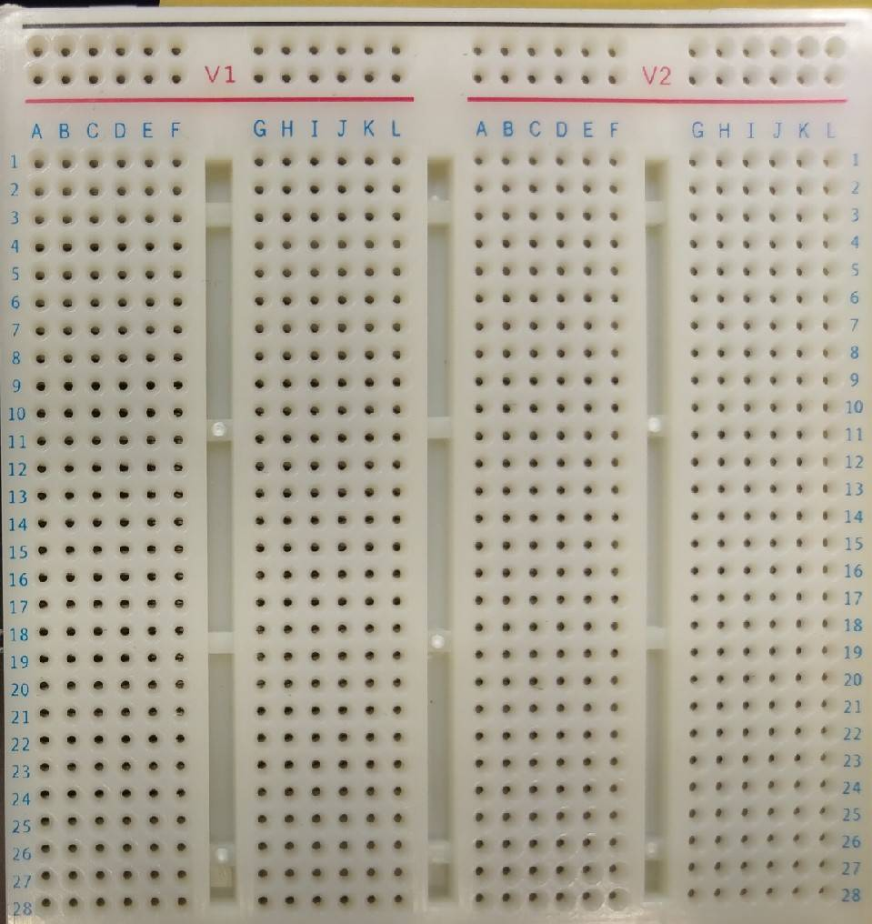
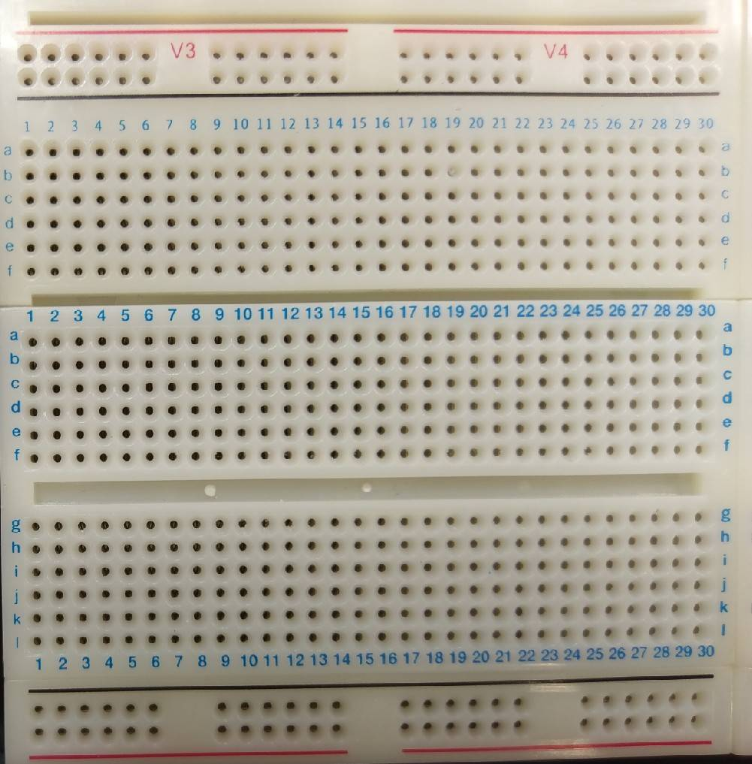
實驗器材和晶片的介紹 - Solderless Breadboard
Top view of the breadboard
: connected : disconnected

Slide 8


實驗器材和晶片的介紹 - Solderless Breadboard
Connection of the Solderless Breadboard
5 V
e
f
e
+
-
5 V
-+
GNDVCC
5 V
V1
f
e
f

Slide 9
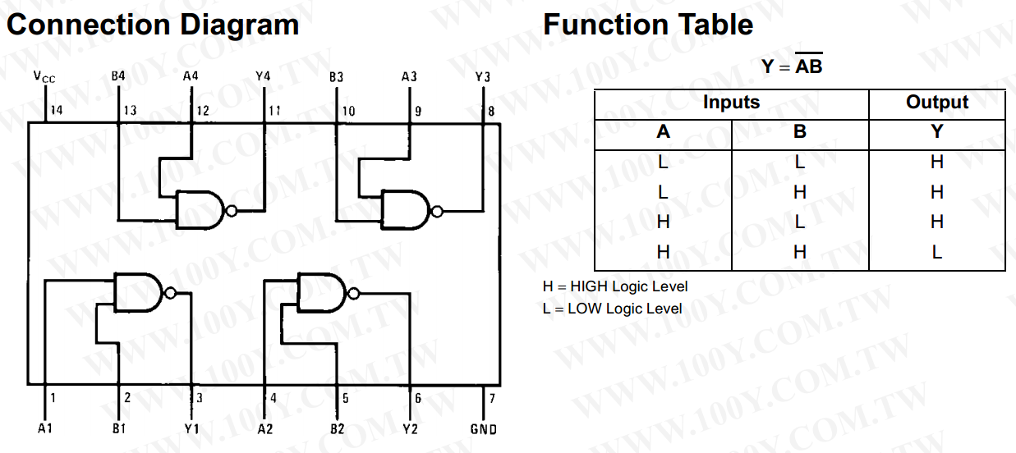
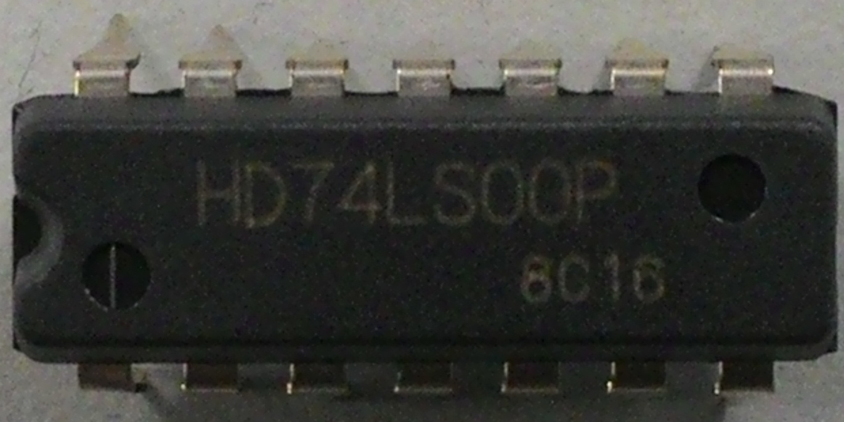
實驗器材和晶片的介紹 - IC
74LS00 (1/3)
NAND gate
Not - AND
Vcc (5V)
10 9 8
1 2 3
ground

Slide 10
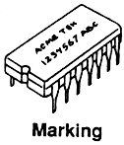
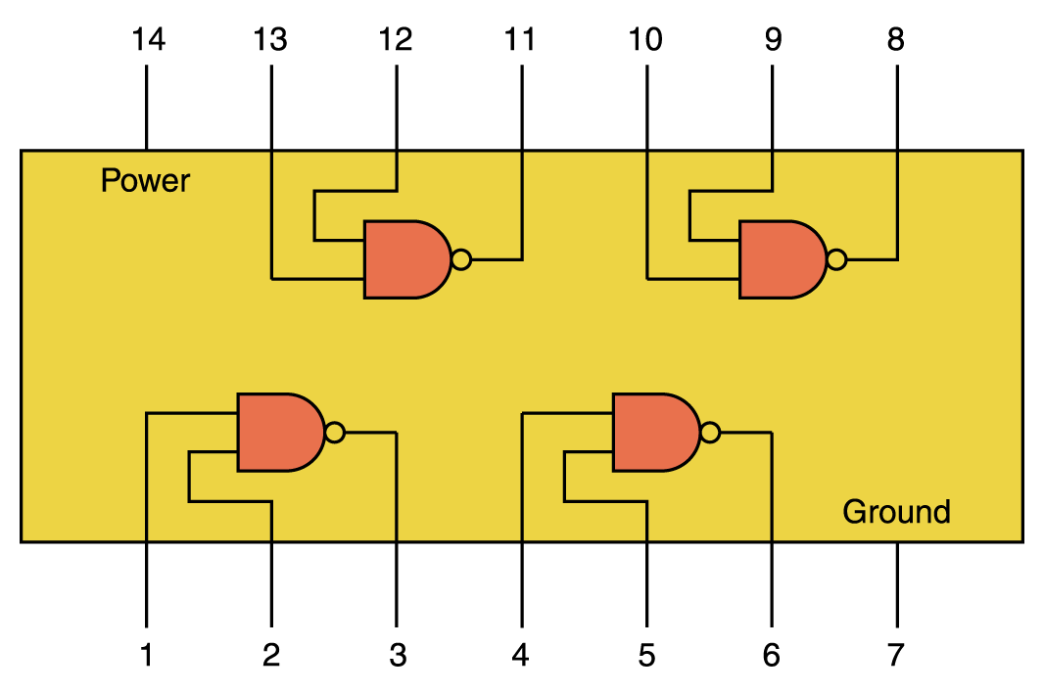
實驗器材和晶片的介紹 - IC
74LS00 (2/3)
ground
1
2
3
11
[2]
9
10
[3]
8
12
[1]
13
[1]
[3]
power
[2]
5 V

Slide 11
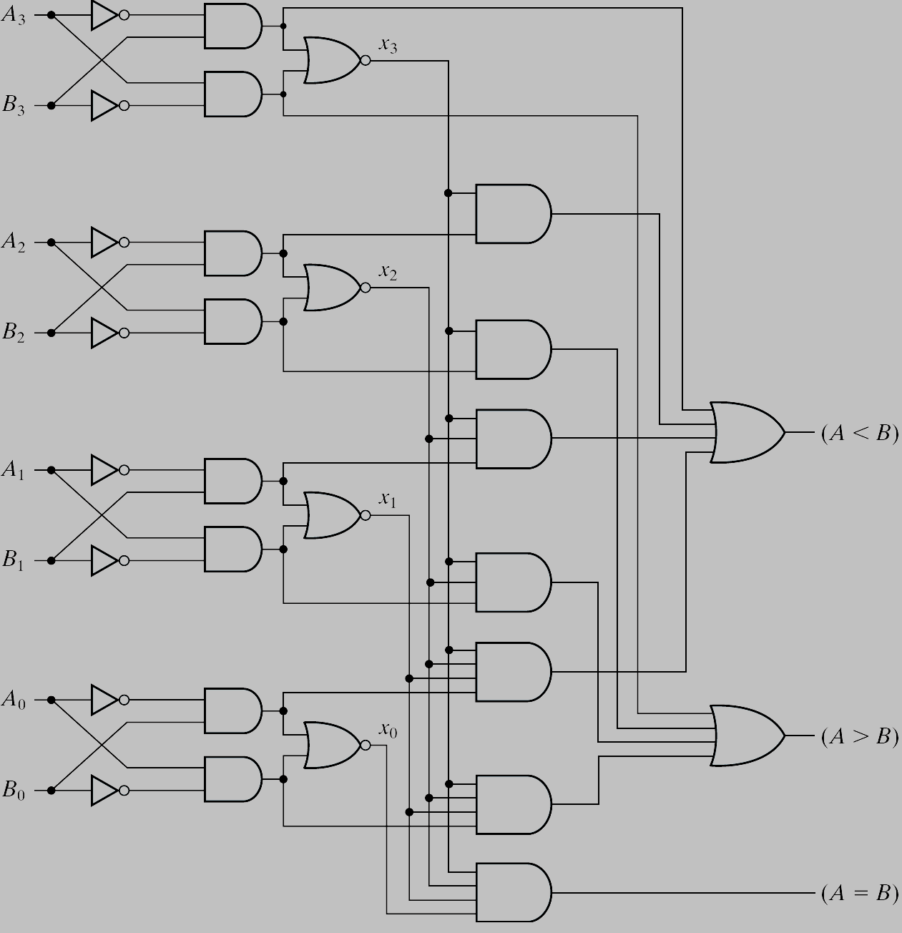
實驗器材和晶片的介紹 - IC
74LS00 (3/3)
1
2
[2]
[3]
8
12
[1]
13
[1]
[3]
[2]
Multiple chips (gates) are used to realize a specific circuit
A dedicated chip (ASIC, application specific integrated circuit)

Slide 12
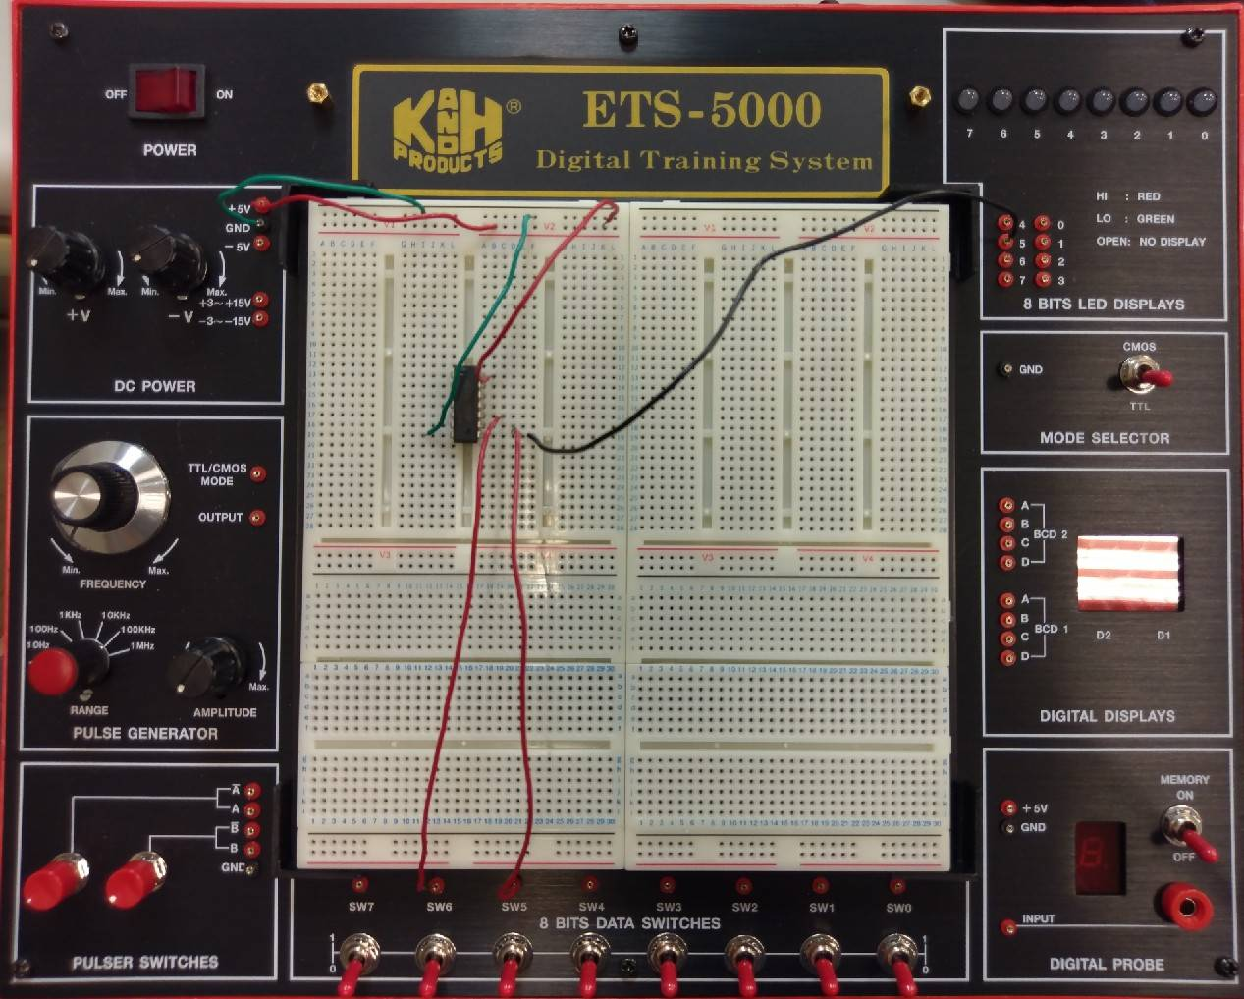
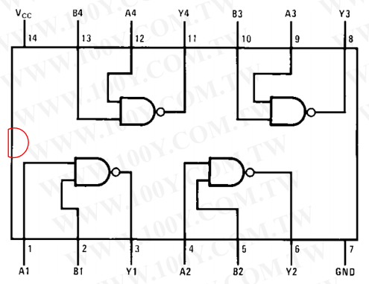
實驗器材和晶片的介紹 - Example
Example 74LS00 Chip(1/7)
Board
output
power supply
TTL mode
Chip(NAND)
Wire connection & IC placement
input

Slide 13
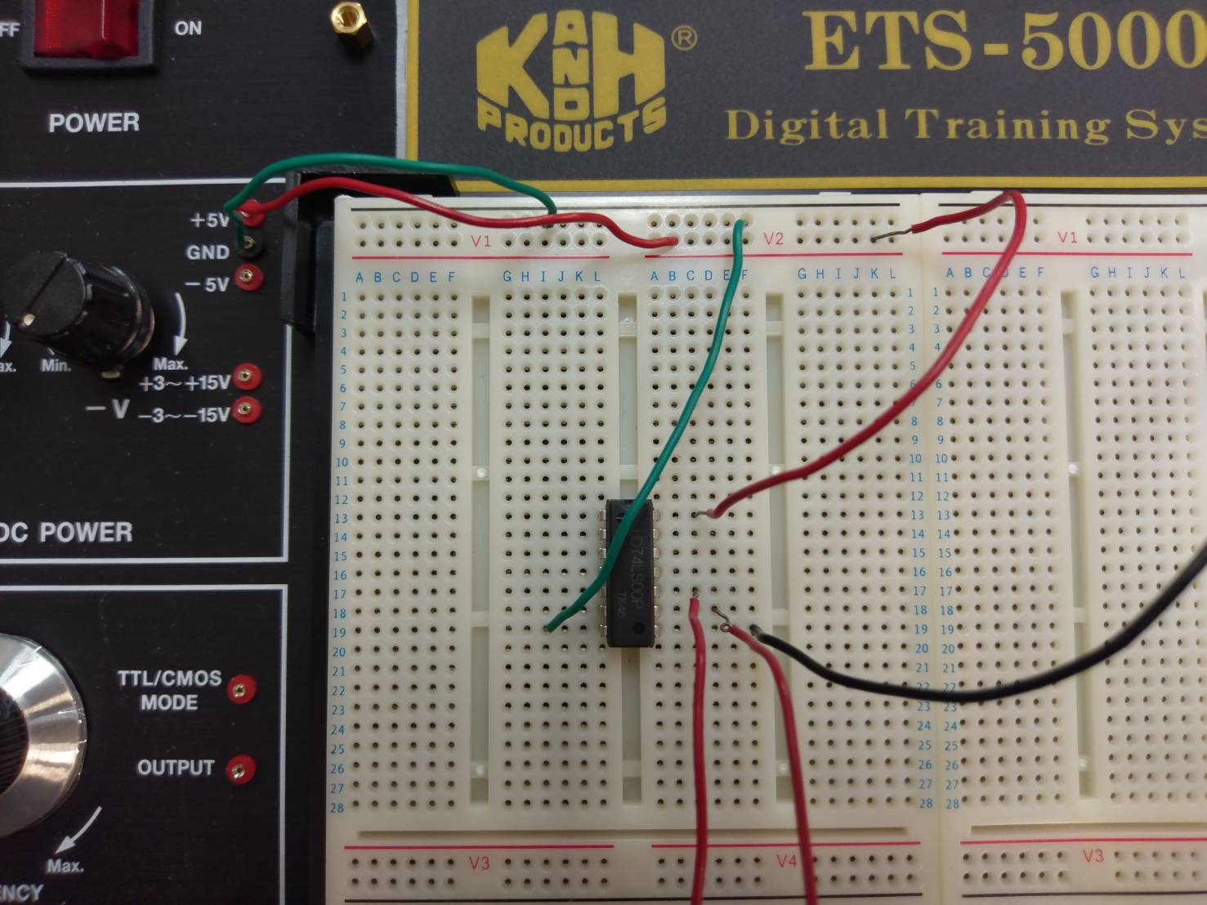
實驗器材和晶片的介紹 - Example
Example 74LS00 Chip(2/7)
Board : wire connection
Chip(NAND)
Vcc (5V)
ground

Slide 14
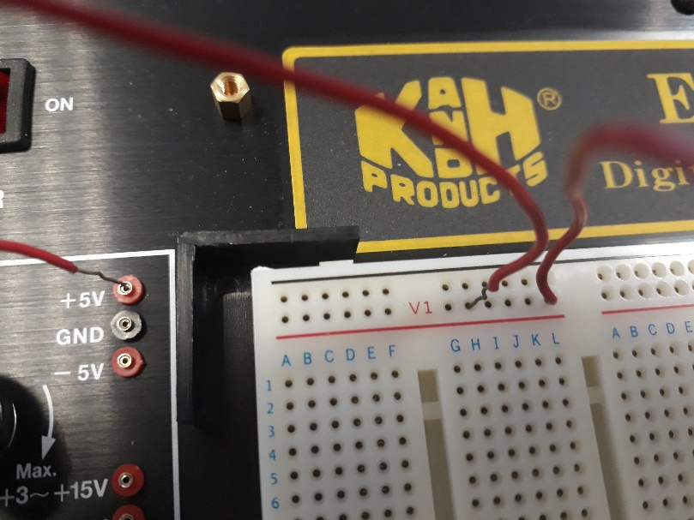
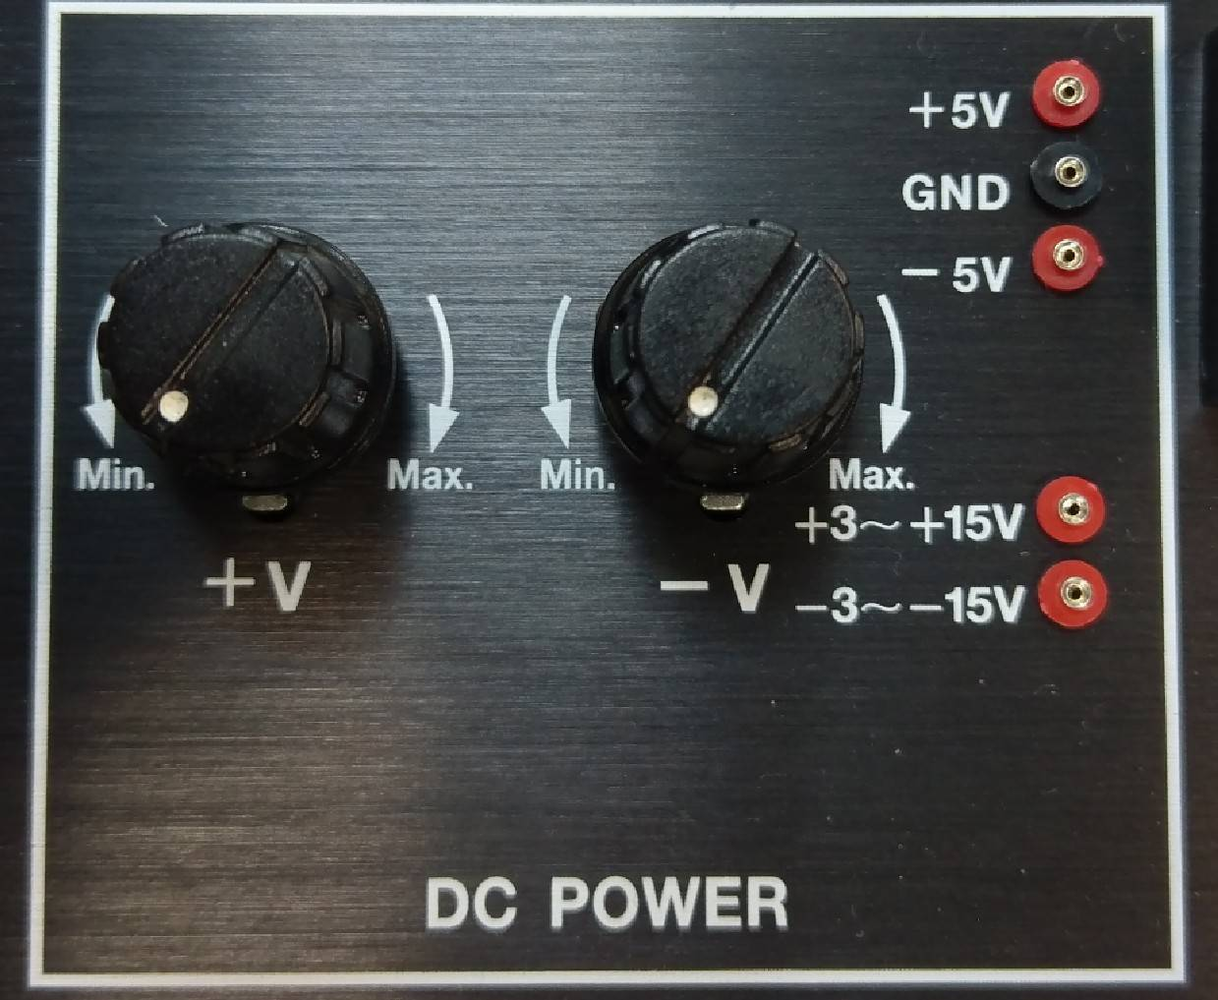
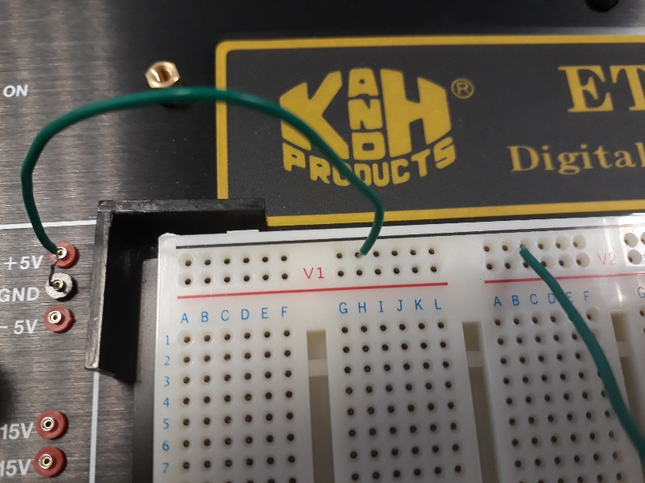
實驗器材和晶片的介紹 - Example
Example 74LS00 Chip(3/7)
VCC
Power supply
Use This
Don’t touch it
GND

Slide 15
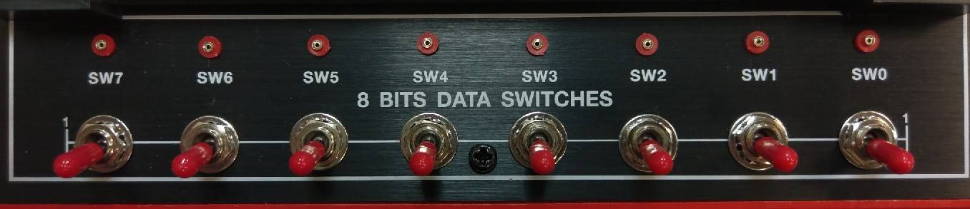
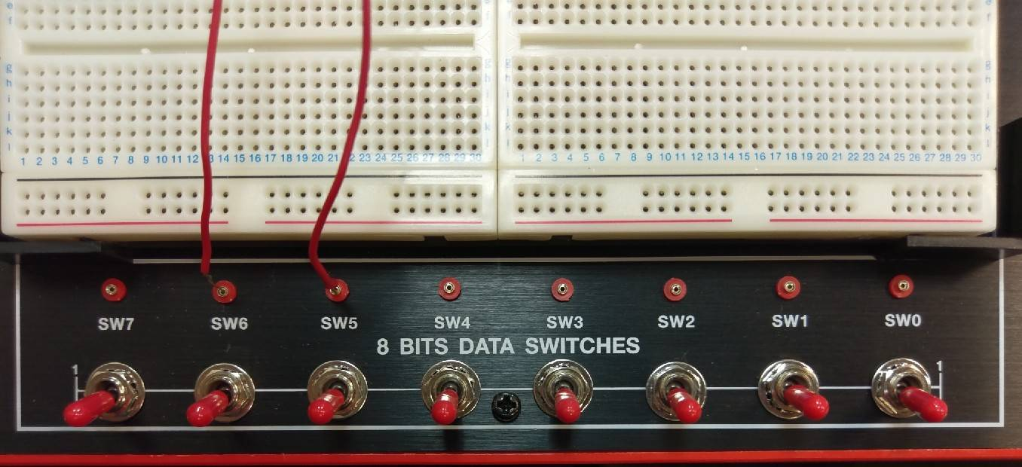
實驗器材和晶片的介紹 - Example
Example 74LS00 Chip(4/7)
Signal input

Slide 16
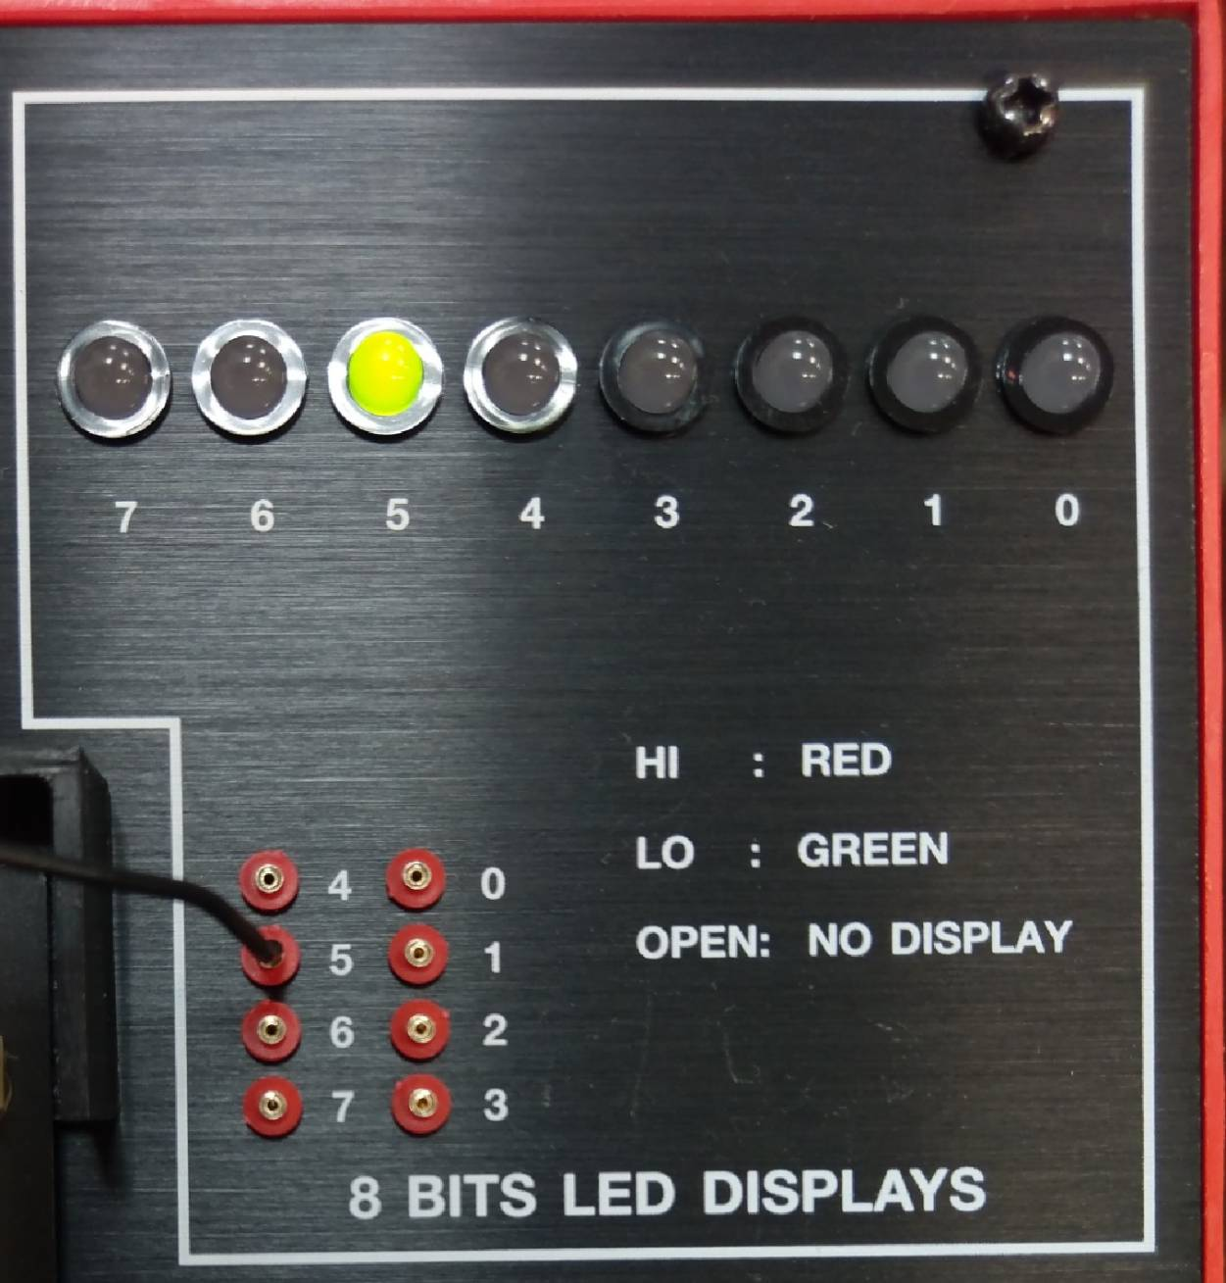
實驗器材和晶片的介紹 - Example
Example 74LS00 Chip(5/7)
Signal output

Slide 17
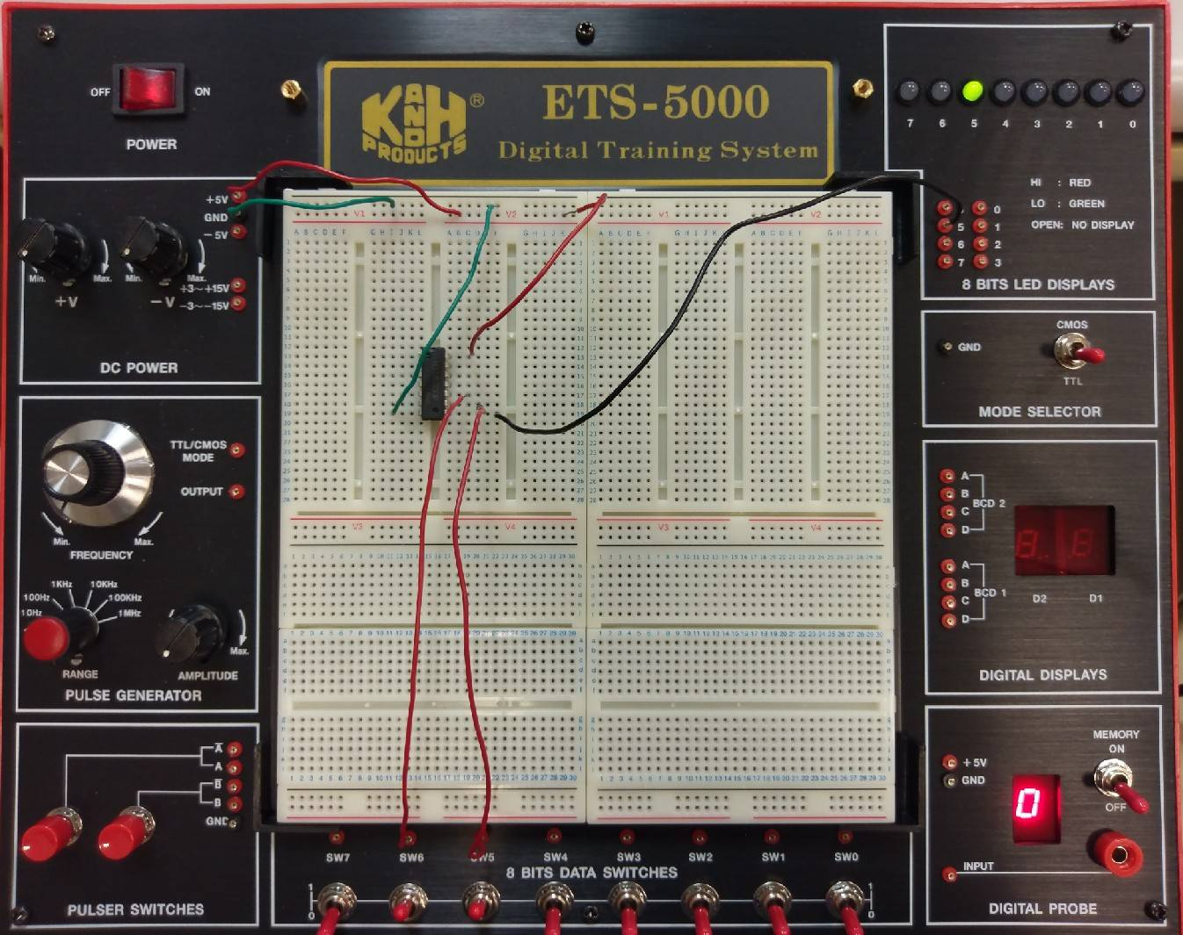
實驗器材和晶片的介紹 - Example
Example 74LS00 Chip(6/7)
Input 11
Output 0
Y
74LS00 truth table
Input |  | Output
A | B | Y
0 | 0 | 1
1 | 0 | 1
0 | 1 | 1
1 | 1 | 0
A
B

Slide 18
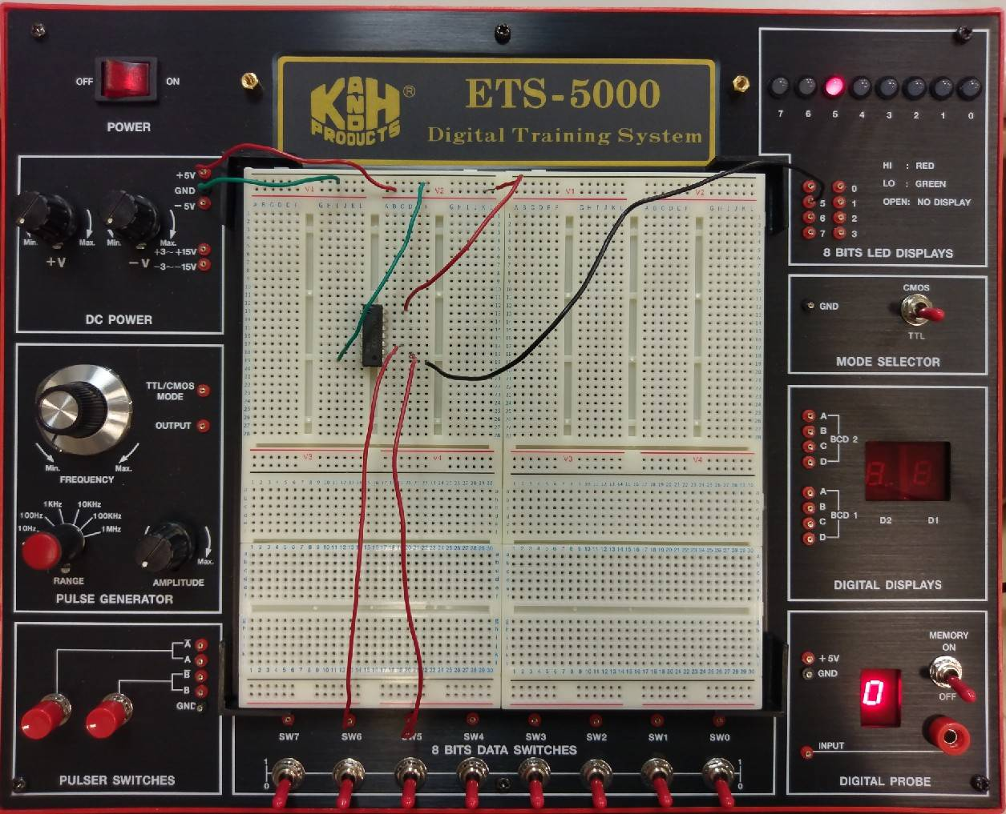
實驗器材和晶片的介紹 - Example
Example 74LS00 Chip(7/7)
Input 00
Output 1
Y
74LS00 truth table
Input |  | Output
A | B | Y
0 | 0 | 1
1 | 0 | 1
0 | 1 | 1
1 | 1 | 0
A
B

Slide 19
74LS00
NAND gate

Slide 20
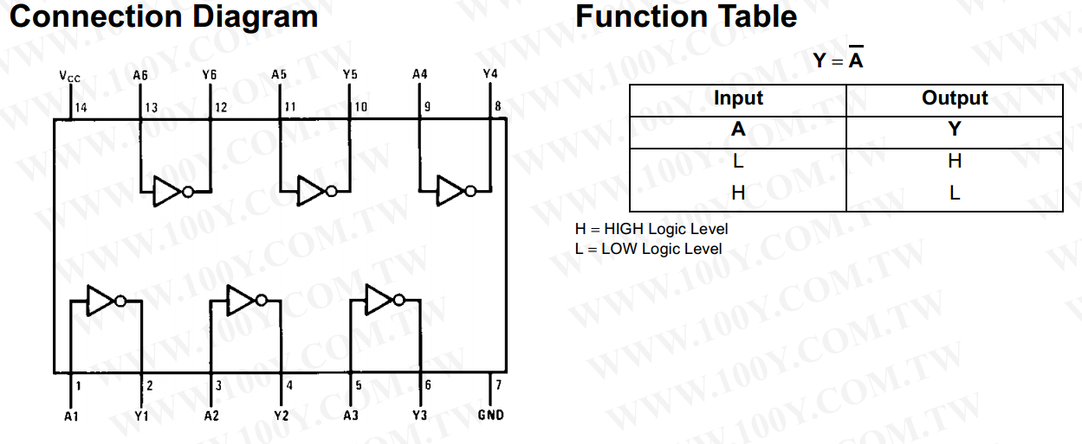
74LS04
NOT gate

Slide 21
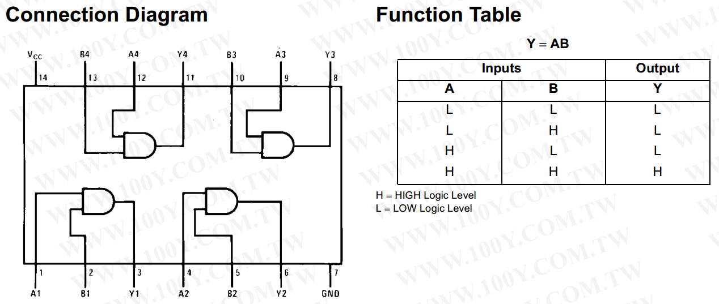
74LS08
AND gate

Slide 22
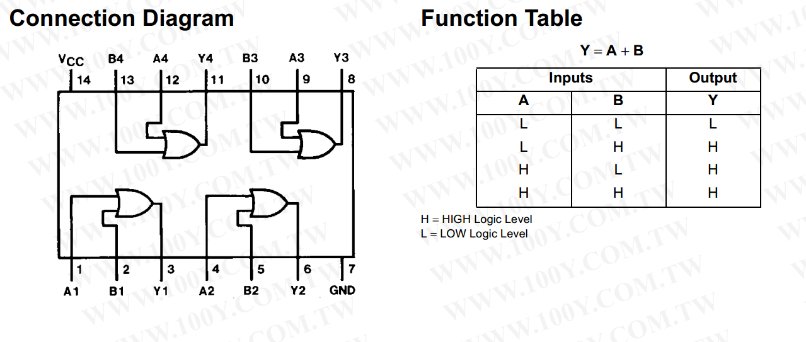
74LS32
OR gate

Slide 23
Lab 說明 - Lab Notice
Names | Amount
Solderless Breadboard | ×1
74LS00 | ×1
74LS04 | ×1
74LS08 | ×1
74LS32 | ×1

Slide 24
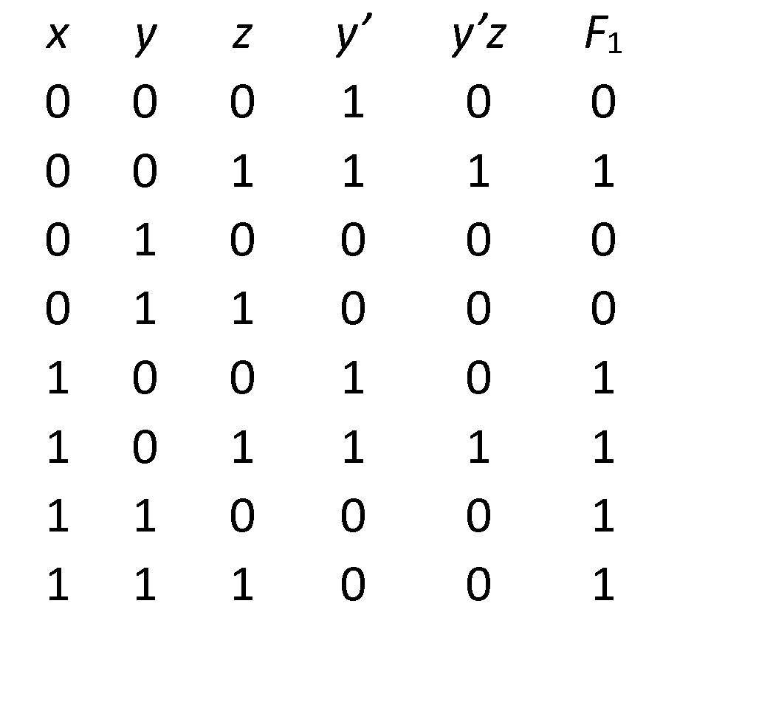
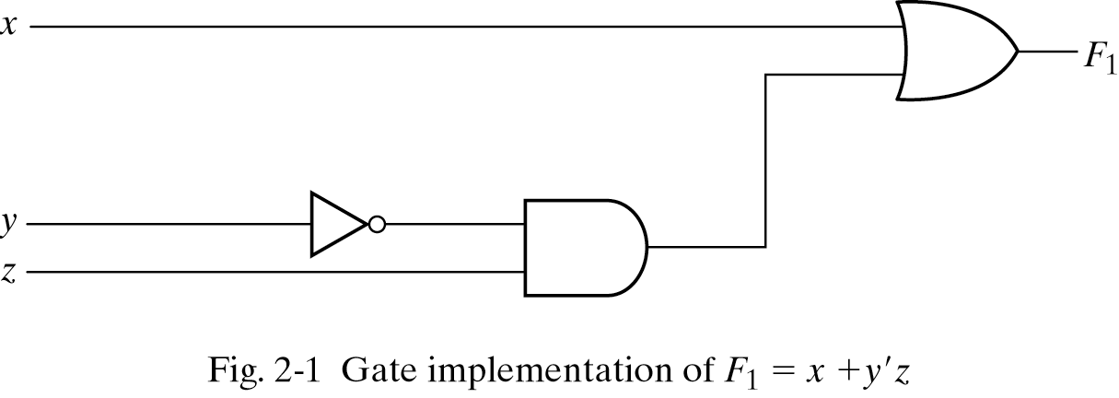
Lab 說明 - Lab Notice
Three representations for a circuit
1. Boolean Algebra
2. Truth Table
真值表
n input variables 🡺 2^{n} combinations
F₁=x+y’z
Inputs
3. Circuit Diagram

Slide 25
Lab 說明 - Lab Notice
Input
Output
ETS-5000
ETS-7000A

Slide 26
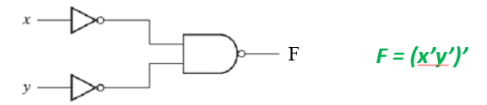
Lab 說明 - Lab 01-1 Circuit Diagram
Please (a) draw the truth table of the following circuit and (b) implement it on the solderless breadboard.
Hint: 74LS00, 74LS04

Slide 27
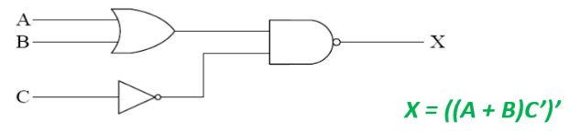
Lab 說明 - Lab 01-2 Circuit Diagram
Please (a) draw the truth table of the following circuit and (b) implement it on the solderless breadboard.
Hint: 74LS00, 74LS04, 74LS32

